Slide 1
EMBT-ESE 4009 Topic: Health monitoring device using IOT -connected headphone.
Group:2
Instructor:Mike Aleshams

Slide 2
Group Members Student ID
Christy Rachel Philip C0765535
Fahad Rahman C0769871
James M Chacko C0777192
Premil Presannan C0777191
Presented by,
James M. Chacko

Slide 3
Topics Covered
Introduction
Hardware Requirement
Ordering components
Reference

Slide 4
Introduction
The topic of our project is “Health monitoring device using IOT-connected headphone.”
Our Project is an IoT-connected health care device, which is connected as a part of Bluetooth headphones. It consists of surface electrodes, temperature sensors, GPS, etc., to obtain various health-related data such as heartbeat rate, temperature, and EKG. We can use multiple EKG and PPG sensors to get the vital information we need to monitor.
The device can be connected to a mobile phone through IoT. The user's information such as height, weight and previous history should be saved in the application. Using this, the family doctor can access it directly to monitor the patient's condition every day and communicate with them

Slide 5
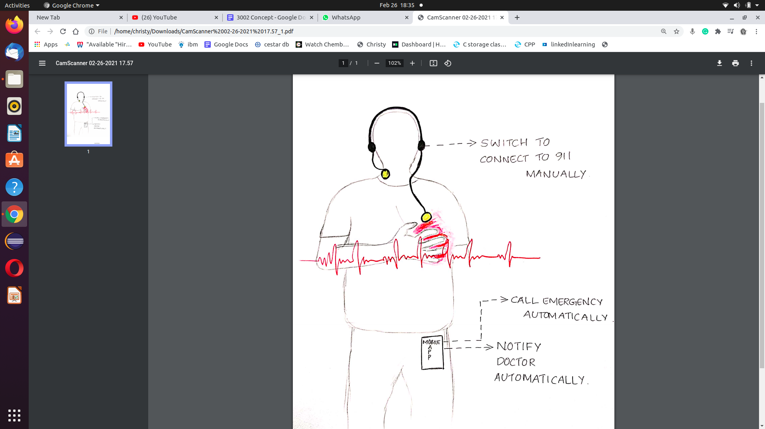
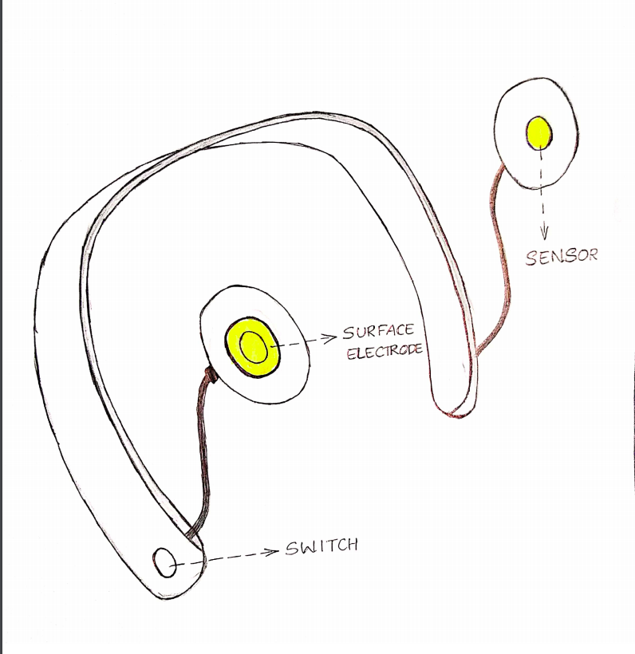
Conceptual Diagram

Slide 6
Part number | Description | Cost | Link
TTGO T-Call V1.3 | ESP32 | 18.73 | https://www.banggood.com/LILYGO-TTGO-T-Call-V1_3-V1_4-ESP32-Wireless-Module-GPRS-Antenna-SIM-Card-SIM800L-Board-p-1527048.html?rmmds=myorder&cur_warehouse=USA
MAX30101 | MAX30102 | 34.40 | https://www.makerfabs.com/max30102-pulse-oximeter-heart-rate-module.html
A-QKY68C | Lithium Ion Battery | 25.99 | https://www.amazon.ca/gp/product/B08CBVNWG4/ref=ewc_pr_img_1?smid=AW1D3WUZUOTMS&psc=1
EDGELEC | Jumper Wires | 8.99 | https://www.amazon.ca/EDGELEC-Breadboard-Optional-Assorted-Multicolored/dp/B07GD1XFWV
DS18B20 | One Wire Digital Temperature Sensor - DS18B20 | 20 | https://www.amazon.ca/gp/product/B012C597T0/ref=ppx_yo_dt_b_asin_title_o02_s00?ie=UTF8&psc=1
GIKFUN | Push Button | 10.98 | https://www.amazon.ca/gp/product/B06Y6DDG8K/ref=ppx_yo_dt_b_asin_title_o00_s00?ie=UTF8&psc=1
Total amount: |  |  | 119.09 CAD

Slide 7
Part number | Description | Cost | Link
MBB-ZH-03 | breadboard Kit | 13.99 | https://www.amazon.ca/gp/product/B091CFCZYB/ref=ppx_yo_dt_b_asin_title_o01_s00?ie=UTF8&psc=1
EFR-W0P25-A:MF | 4.7K ohm Resistor | 10 | https://www.amazon.sg/EDGELEC-4-7K-ohm-±1-Resistance/dp/B07HDFHPP3
SPARKFUN BEGINNER TOOL KIT | Basic Electronics Kit (Cutters, Wires, Multimeters, etc) | 70 | https://elmwoodelectronics.ca/products/14681
NEO-6M | GPS Module | 12.18 | https://www.walmart.ca/en/ip/396CEYMXA43T
Total amount: |  |  | 225.26 CAD

Slide 8
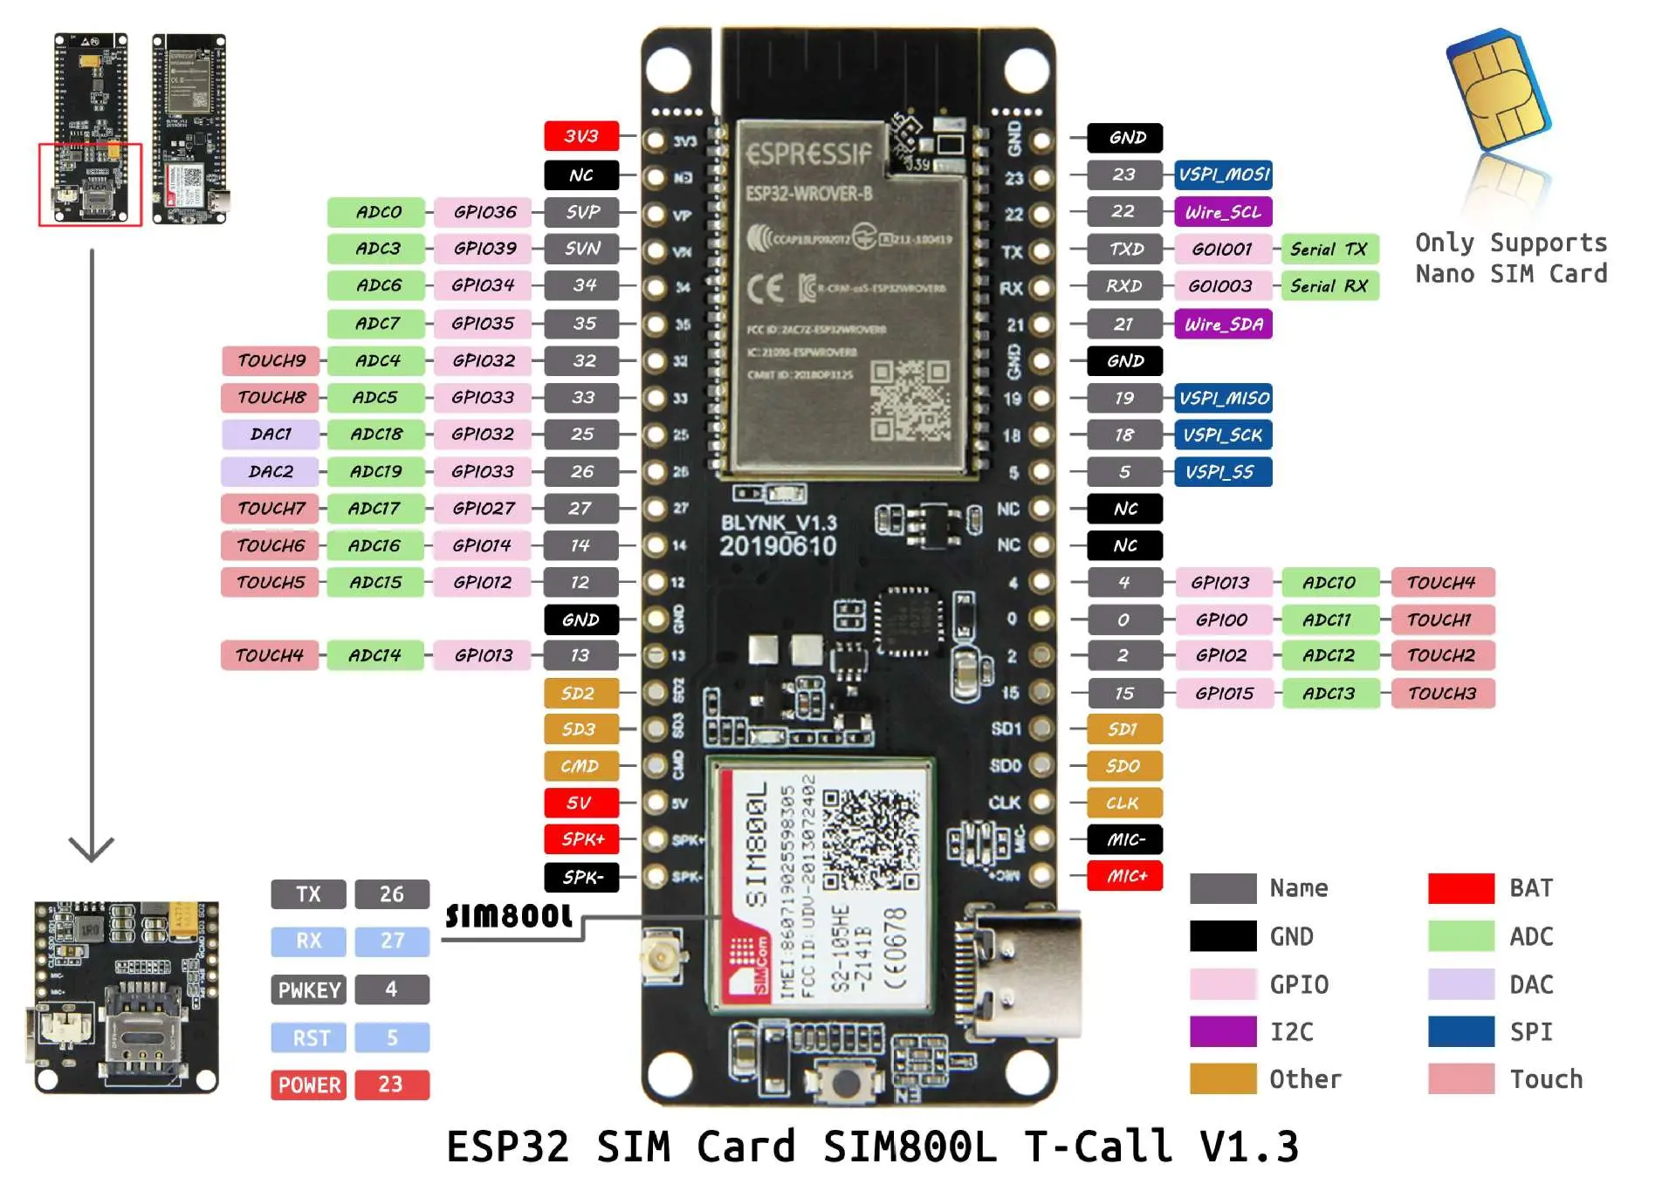
ESP32 Wireless Module

Slide 9
ESP32 Wireless Module
FEATURES
The ESP32 is an updated version of the ESP8266.The ESP32 improved upon the ESP32 design in a number of ways. It offers both Bluetooth and BLE (Bluetooth Low Energy), whereas the ESP8266 only has WiFi (which, of course, the ESP32 also has). It is faster and is available in a dual-core design. It is also capable of operating in an ultra-low-power mode, ideal for battery-powered applications
Main features include
Up to 18 12-bit Analog to Digital converters.
Two 8-bit Digital to Analog converters.
10 capacitive touch switch sensors.
Four SPI channels.
Two I2C interfaces.

Slide 10
Two I2S interfaces (for digital audio).
Three UARTs for communications.
Up to 8 channels of IR remote control.
Up to 16 channels of LED PWM (pulse width modulation).
An integrated Hall-effect sensor.
An ultra-low-power analog preamp.
An internal low-dropout regulator.
The ESP32 can be programmed using many different development environments. Code can be written in C++ (like the Arduino) or in MicroPython.To make use of all of the ESP32 features Espressif provided the Espressif IoT Development Framework, or ESP-IDF.

Slide 11
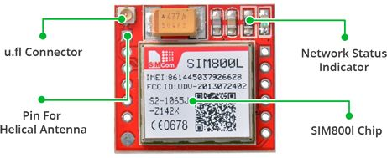
GSM Module-Sim 800L
Features
At the heart of the module is a SIM800L GSM cellular chip from SimCom. The operating voltage of the chip is from 3.4V to 4.4V, which makes it an ideal candidate for direct LiPo battery supply. This makes it a good choice for embedding into projects without a lot of space. All the necessary data pins of SIM800L GSM chip are broken out to a 0.1″ pitch headers. This includes pins required for communication with a microcontroller over UART. The module supports baud rate from 1200bps to 115200bps with Auto-Baud detection.

Slide 12
Supports Quad-band: GSM850, EGSM900, DCS1800 and PCS1900
Connect onto any global GSM network with any 2G SIM
Make and receive voice calls using an external 8Ω speaker & electret microphone
Send and receive SMS messages
Send and receive GPRS data (TCP/IP, HTTP, etc.)
Scan and receive FM radio broadcasts
Transmit Power:
Class 4 (2W) for GSM850
Class 1 (1W) for DCS1800
Serial-based AT Command Set
FL connectors for cell antennae
Accepts Micro SIM Card

Slide 13
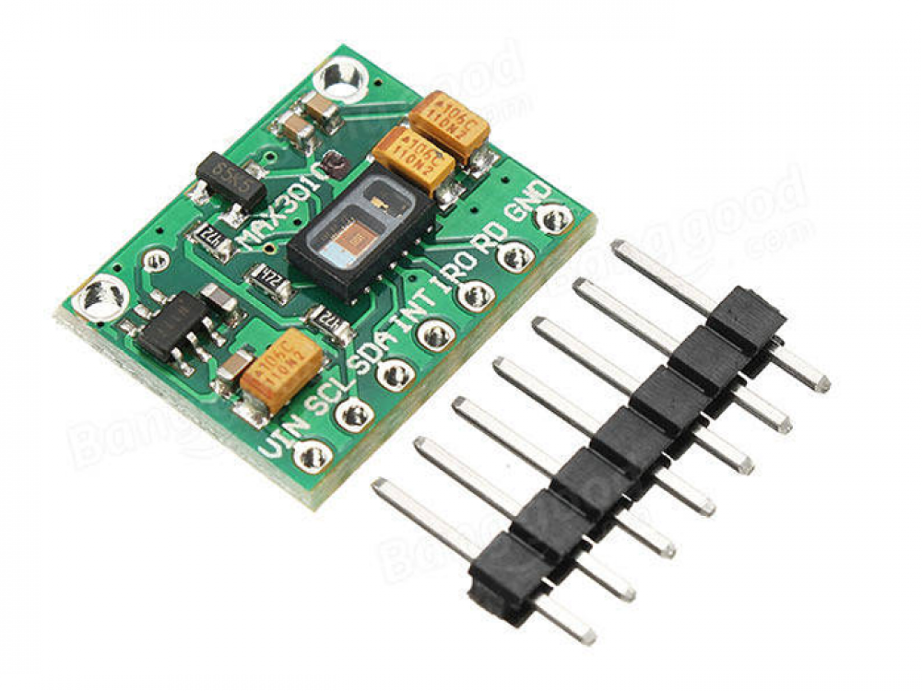
Max30102
MAX30102 based pulse oximetry and heart-rate monitor breakout board. It includes internal LEDs, photodetectors, optical elements, and low-noise electronics with ambient light rejection. The MAX30102 provides a complete system solution to ease the design-in process for mobile and wearable devices. The MAX30102 operates on a single 1.8V power supply and a separate 3.3V power supply for the internal LEDs. Communication is through a standard I2C-compatible interface. The module can be shut down through software with zero standby current, allowing the power rails to remain powered at all times.It is widely used in wearable devices, fitness assistant devices, smartphones and tables.

Slide 14
The MAX30102 is a complete pulse oximetry and heart-rate sensor system solution module designed for the demanding requirements of wearable devices. The device maintains a very small solution size without sacrificing optical or electrical performance. Minimal external hardware components are required for integration into a wearable system. The MAX30102 is fully adjustable through software registers, and the digital output data can be stored in a 32-deep FIFO within the IC. The FIFO allows the MAX30102 to be connected to a microcontroller or processor on a shared bus, where the data is not being read continuously from the MAX30102’s registers.
Specifications:
LED Peak Wavelength: 660nm/880nm
LED Supply Voltage: 3.3~5V
Interface: I2C Interface
Operating Temperature Range: -40°C to +85°C
Dimension: 20.3 x 15.2mm

Slide 15
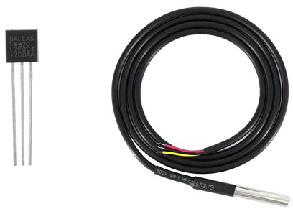
Ds18b20-Temperature sensor
DS18B20 is 1-Wire interface Temperature sensor manufactured by Dallas Semiconductor Corp. The unique 1-Wire Interface requires only one digital pin for two way communication with a microcontroller.

Slide 16
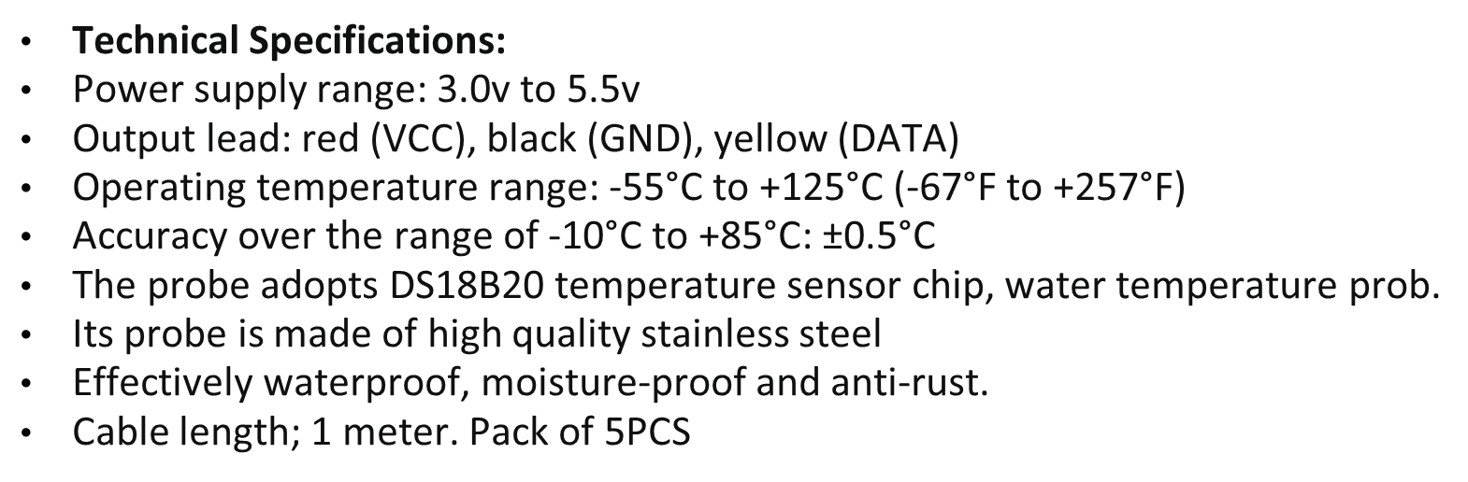

Slide 17
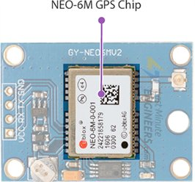
Neo 6M –GPS Module
This module is a NEO-6M GPS chip from u-blox. The chip measures less than the size of a postage stamp but packs a surprising amount of features into its little frame.

Slide 18
Neo 6M –GPS Module
It can track up to 22 satellites on 50 channels and achieves the industry’s highest level of sensitivity i.e. -161 dB tracking, while consuming only 45mA supply current.
Unlike other GPS modules, it can do up to 5 location updates a second with 2.5m Horizontal position accuracy. The u-blox 6 positioning engine also boasts a Time-To-First-Fix (TTFF) of under 1 second.
One of the best features the chip provides is Power Save Mode(PSM). It allows a reduction in system power consumption by selectively switching parts of the receiver ON and OFF. This dramatically reduces power consumption of the module to just 11mA making it suitable for power sensitive applications like GPS wristwatch.
The necessary data pins of NEO-6M GPS chip are broken out to a 0.1″ pitch headers. This includes pins required for communication with a microcontroller over UART. The module supports baud rate from 4800bps to 230400bps with default baud of 9600.

Slide 19

Push Button
Rated Load: DC12V 50mA
Life >100000 times
50pcs 6 x 6 x 4.3mm TACT Switch Push Button

Slide 20
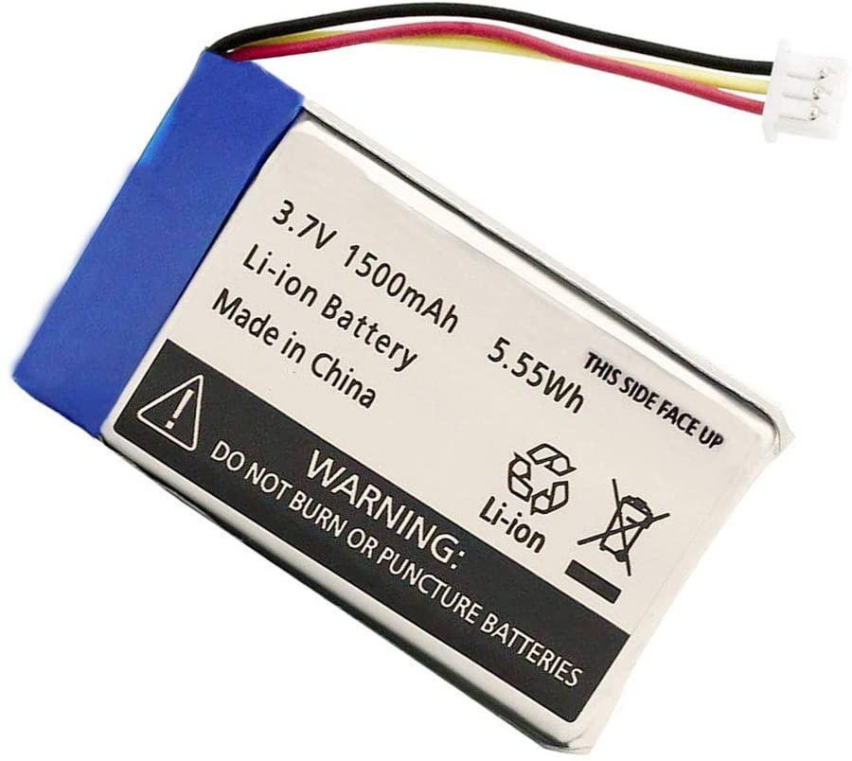
Lithium Ion Battery
These are the latest in rechargeable battery technology, and are quickly becoming the most common batteries for consumer electronics like camcorders, cell phones, laptops etc. They are very lightweight, don't mind high discharge rates, and have very high power density. However, they are very delicate and require special circuitry to keep them from exploding! This means that raw LiIon cells are very rare and very dangerous. Most li-ion batteries come with protection circuitry that keeps the battery operating safely. Li-Ion cells are around 3.6V so 3.6V and 7.2V are the most common battery voltages you'll see. They can easily provide up to 1C of current, some can go up to 10C! Pros: Ultra-light, high power, high capability, high cell voltage. Cons: Expensive, delicate, can explode if misused!

Slide 21
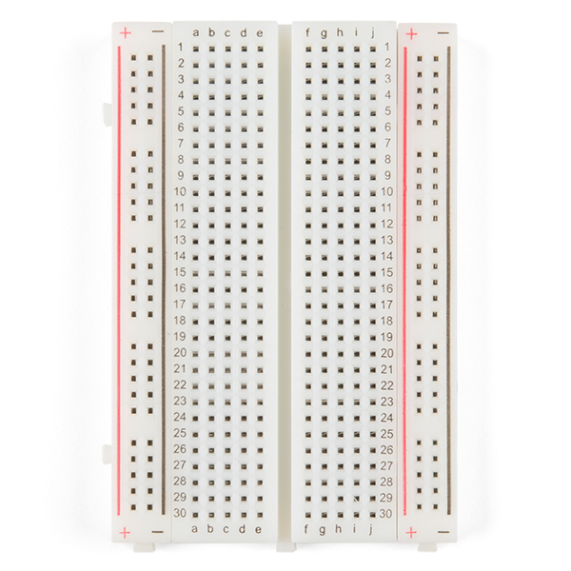
Breadboard
An electronics breadboard (as opposed to the type on which sandwiches are made) is actually referring to a solderless breadboard. These are great units for making temporary circuits and prototyping, and they require absolutely no soldering.

Slide 22
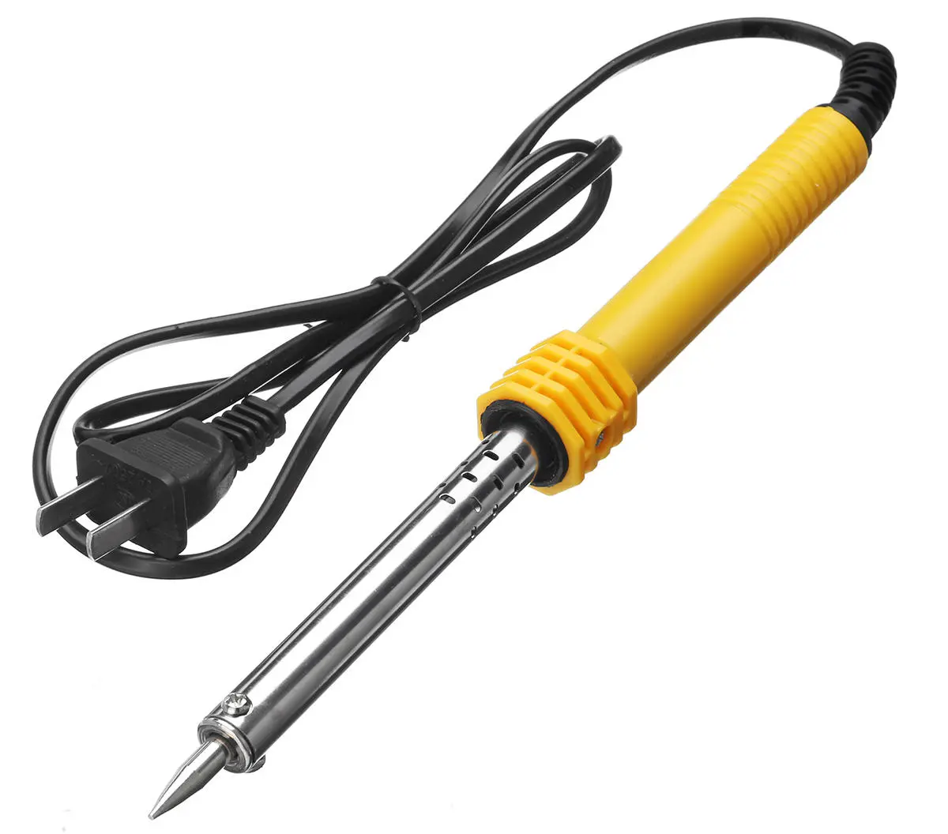
Soldering iron
A soldering iron is a hand tool used to heat solder, usually from an electrical supply at high temperatures above the melting point of the metal alloy. This allows for the solder to flow between the workpieces needing to be joined.
This soldering tool is made up of an insulated handle and a heated pointed metal iron tip. Good soldering is influenced by how clean the tip of your soldering iron is. To maintain cleanliness, a user will hold the soldering iron and use a wet sponge to clean the soldering iron tip prior to soldering components or making soldered connections.

Slide 23
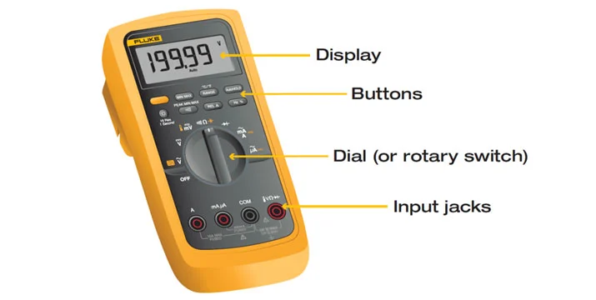
Multimeter
￼
A digital multimeter is a test tool used to measure two or more electrical values—principally voltage (volts), current (amps) and resistance (ohms). It is a standard diagnostic tool for technicians in the electrical/electronic industries. Digital multimeters combine the testing capabilities of single-task meters—the voltmeter (for measuring volts), ammeter (amps) and ohmmeter (ohms). Often, they include several additional specialized features or advanced options. Technicians with specific needs, therefore, can seek out a model targeted to meet their needs.
The face of a digital multimeter typically includes four components:
Display: Where measurement readouts can be viewed.
Buttons: For selecting various functions; the options vary by model.
Dial (or rotary switch): For selecting primary measurement values (volts, amps, ohms).
Input jacks: Where test leads are inserted.

Slide 24
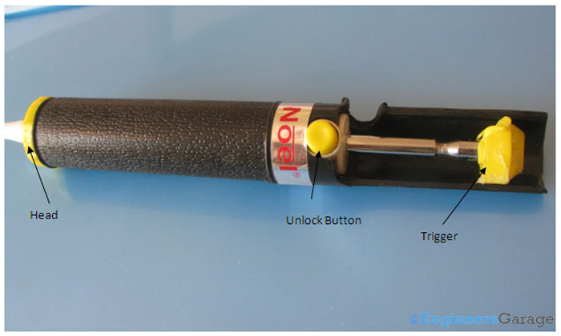
Desoldering Pump
DESOLDERING is the process of removing soldered components from a circuit made on PCB. Desoldering pump along with the soldering iron is used for this purpose. A desoldering pump also known as solder sucker is a small mechanical device which sucks the liquid/molten solder from the joint where the components are mounted. In order to desolder a component from the PCB, we first heat up the solder joint with the soldering iron till the solder liquefies/melts. At the same moment we actuate the soldering pump by pressing the trigger lever and bring the tip over the molten metal and pull the trigger back by pressing a button

Slide 25
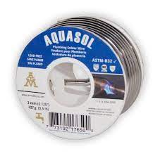
Solder Lead free
Solder is a fusible metal alloy used to create a permanent bond between metal workpieces. Solder is melted in order to adhere to and connect the pieces after cooling, which requires that an alloy suitable for use as solder have a lower melting point than the pieces being joined

Slide 26
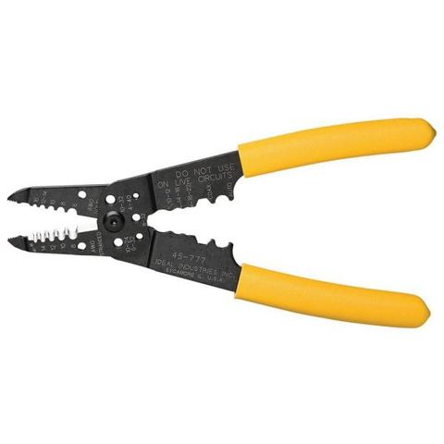
Wire stripper
A wire stripper is a portable handheld tool used by workers, especially electricians, for removing the protective coating of an electric wire in order to replace or repair the wire. It is also capable of stripping the end portions of an electric wire in order to connect them to other wires or to terminals. A wire stripper is often considered an important tool for professional electricians and other related personnel.

Slide 27
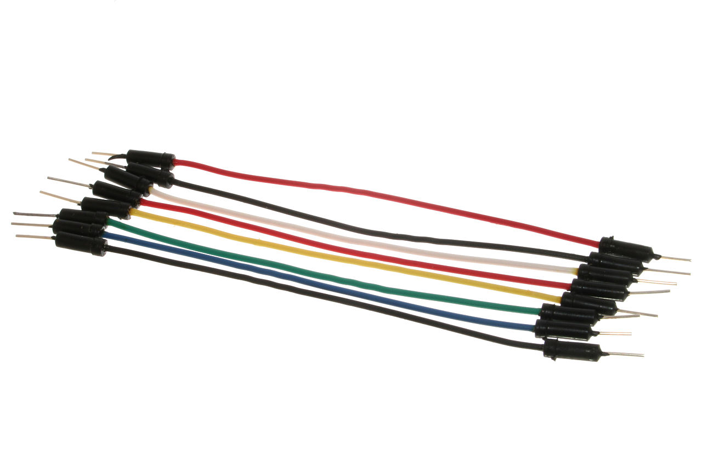
Jumper wire
A jump wire (also known as jumper, jumper wire, jumper cable, DuPont wire or cable) is an electrical wire, or group of them in a cable, with a connector or pin at each end (or sometimes without them – simply "tinned"), which is normally used to interconnect the components of a breadboard or other prototype or test circuit, internally or with other equipment or components, without soldering.
Individual jump wires are fitted by inserting their "end connectors" into the slots provided in a breadboard, the header connector of a circuit board, or a piece of test equipment.

Slide 28
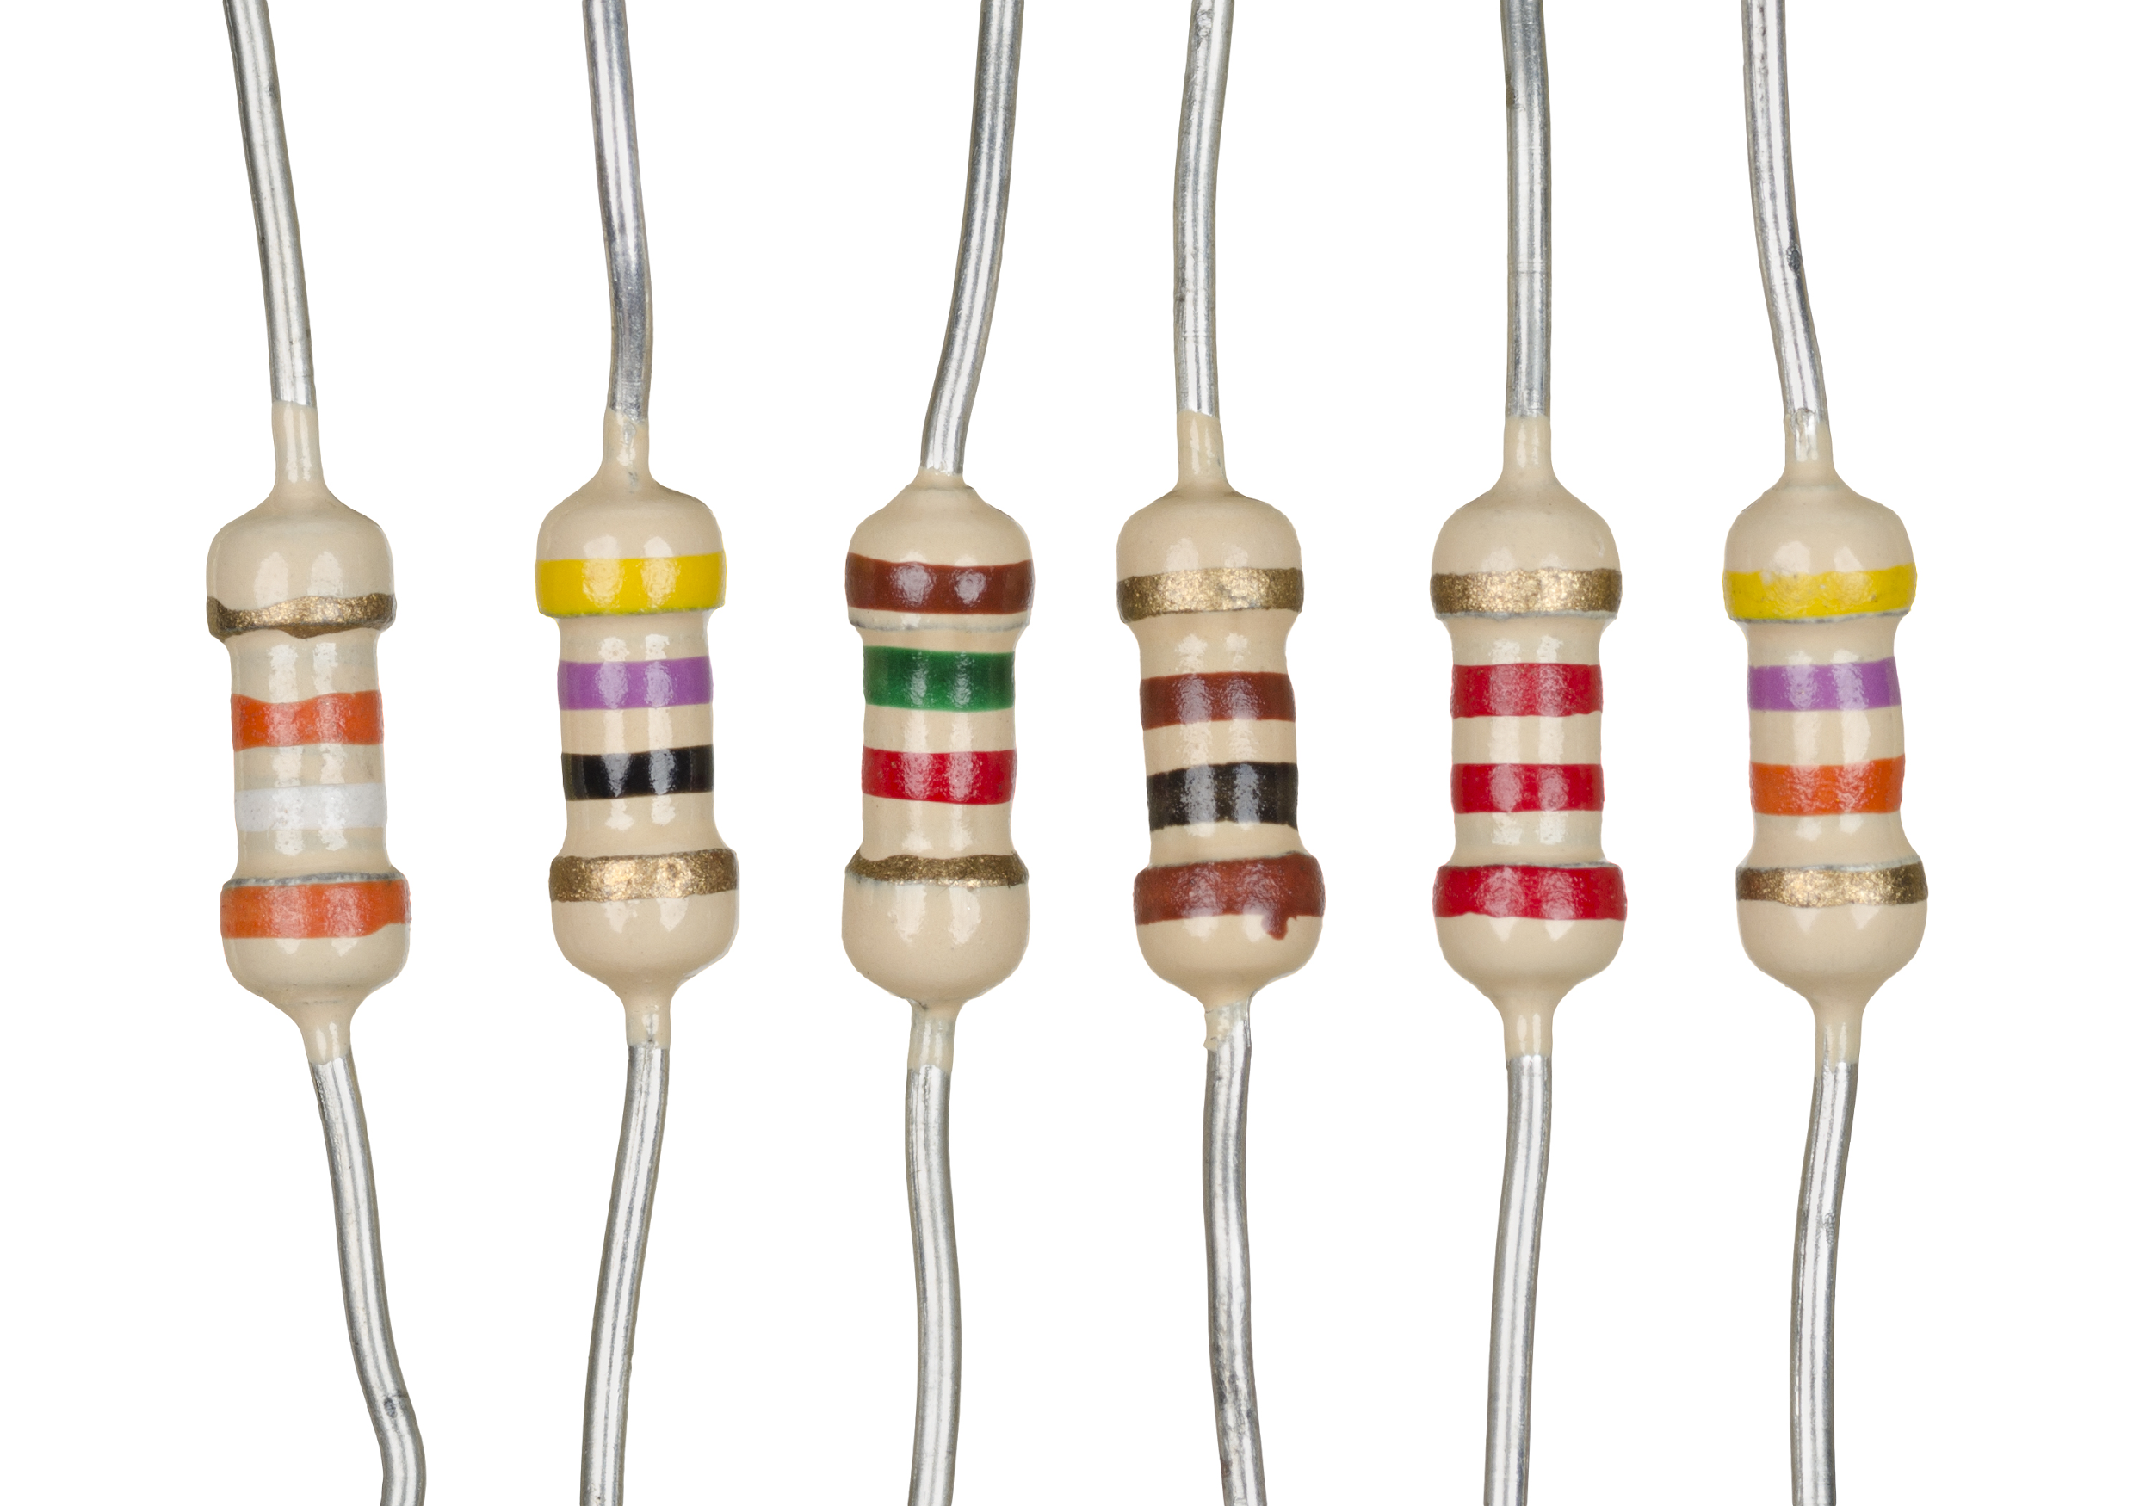
Resistor
A resistor is a passive two-terminal electrical component that implements electrical resistance as a circuit element. In electronic circuits, resistors are used to reduce current flow, adjust signal levels, to divide voltages, bias active elements, and terminate transmission lines, among other uses.

Slide 29
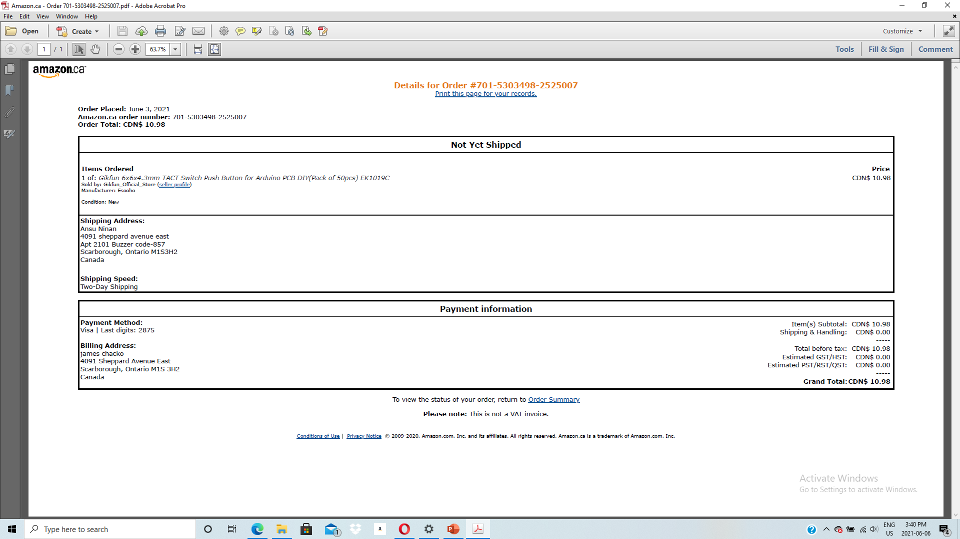
Receipt

Slide 30
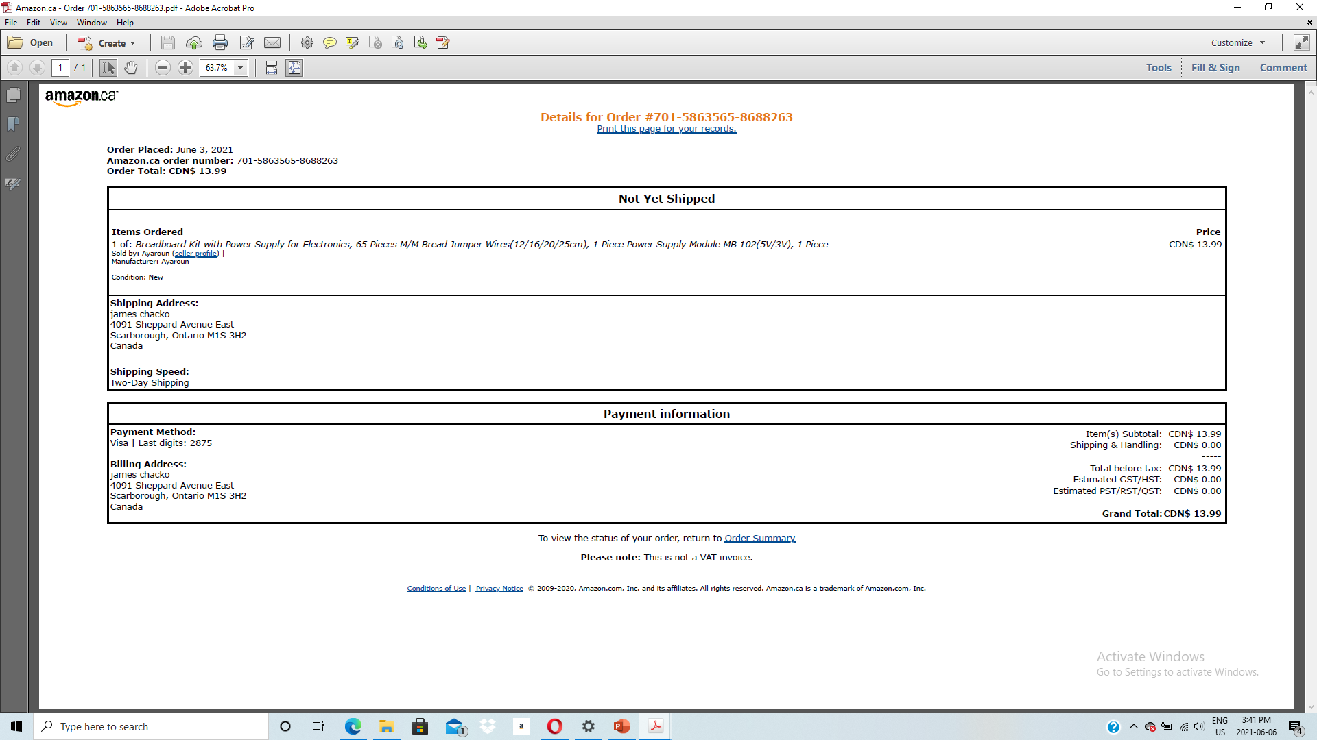
Receipt

Slide 31
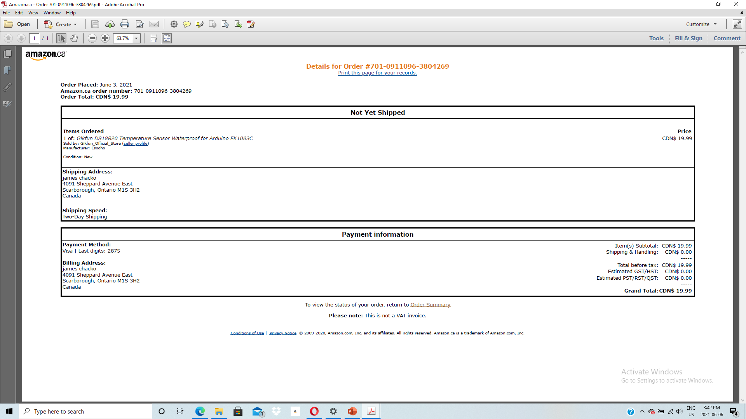
Receipt

Slide 32
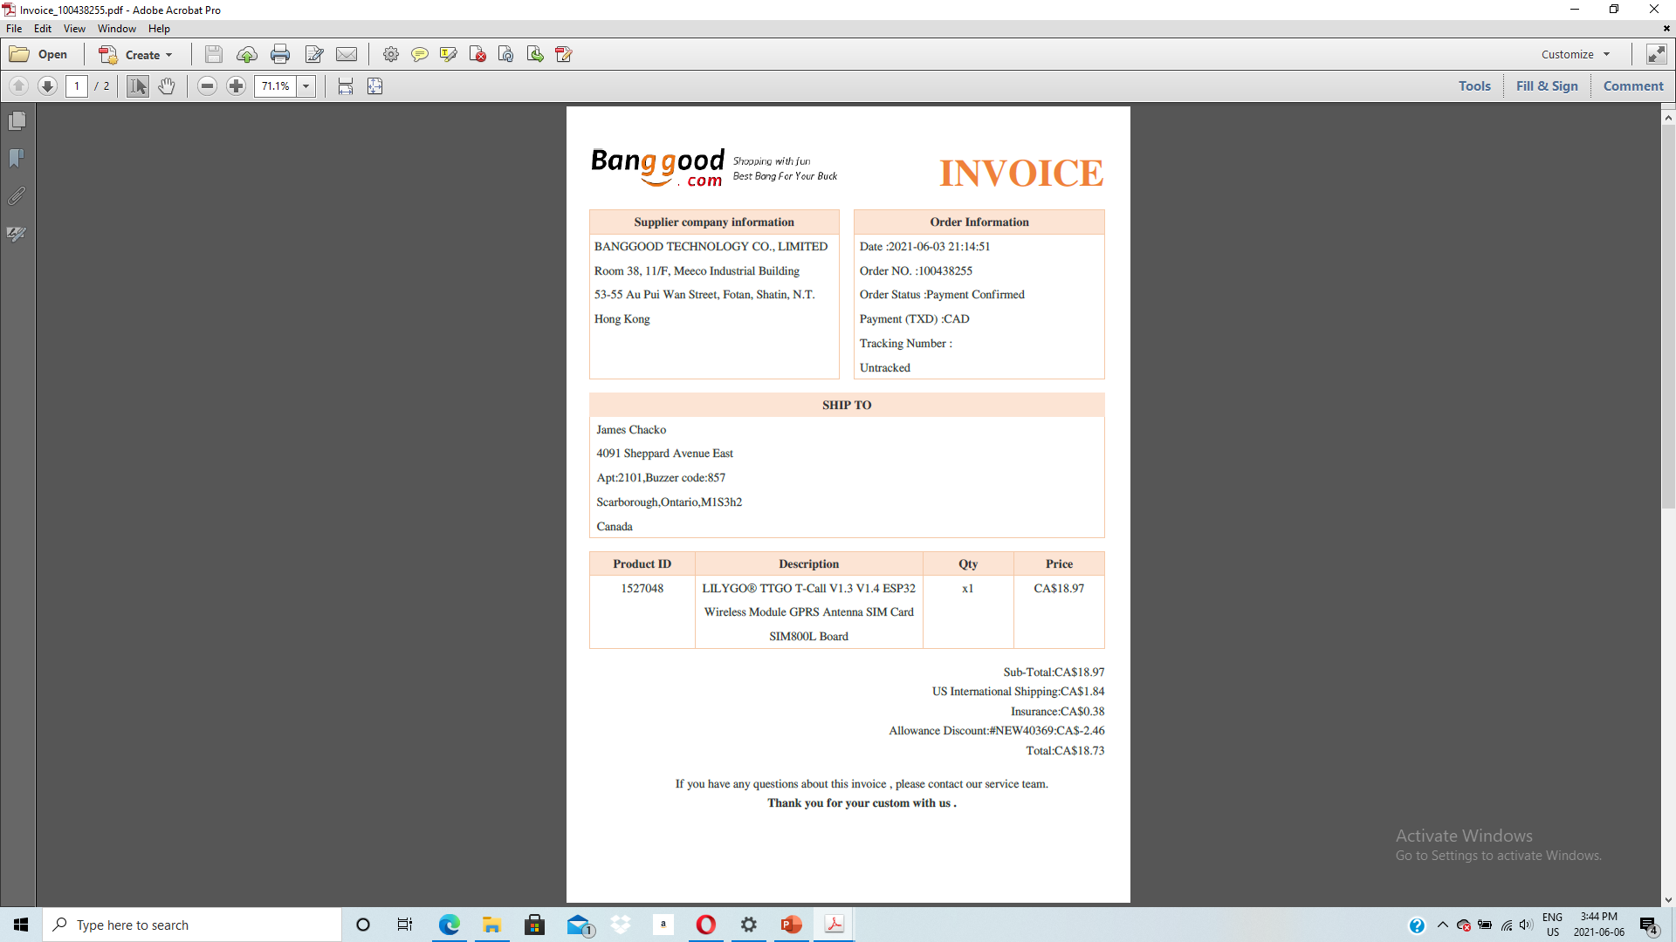
Receipt

Slide 33
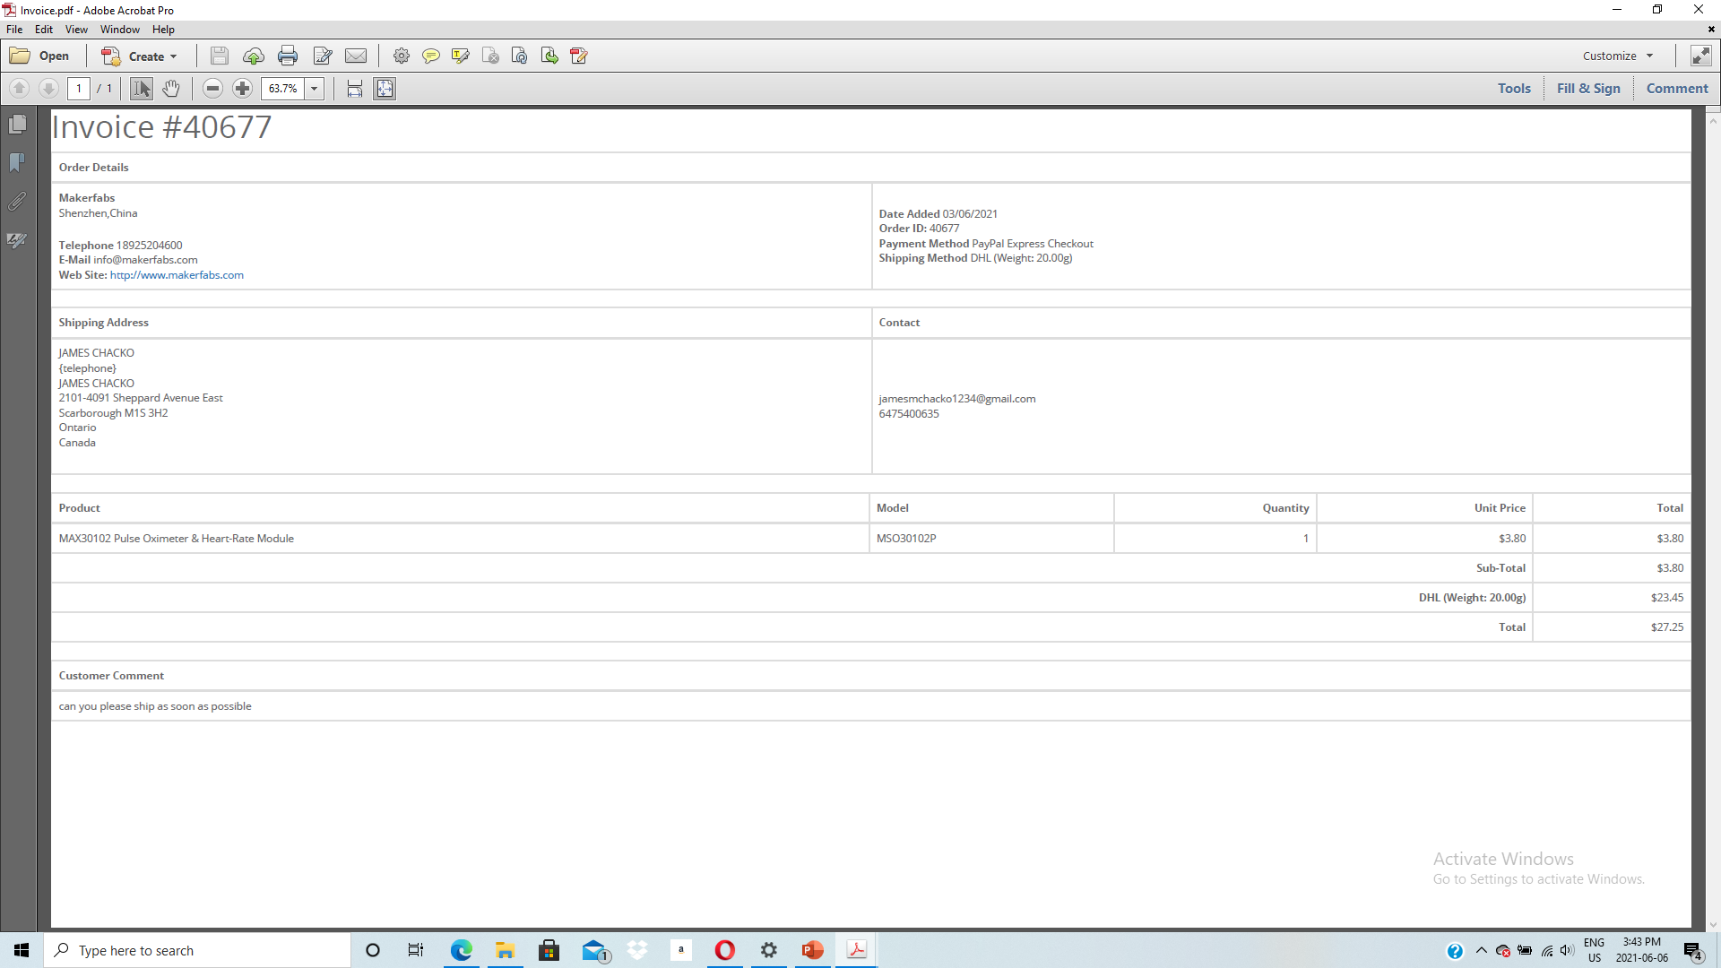
Receipt

Slide 34
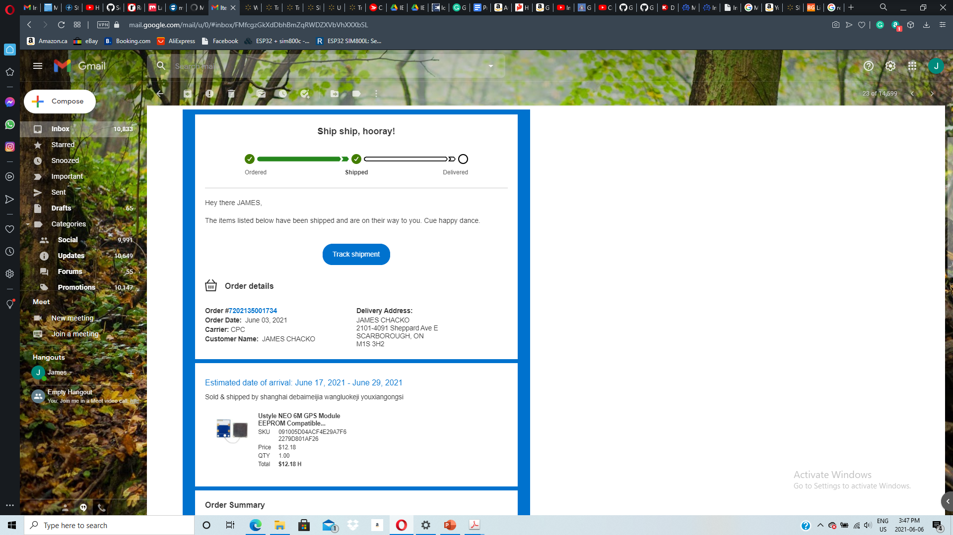
Receipt

Slide 35
References
Dronebot workshop. (2020, April 2). Getting started with ESP32. Learn to use the ESP32. https://dronebotworkshop.com/esp32-intro/
Last minute Engineers. (n.d.). Sim800 L. Sim800L. https://lastminuteengineers.com/sim800l-gsm-module-arduino-tutorial/
Maxim Integrated. (2014, September 24). MAX30100. Pulse Oximeter and Heart-Rate Sensor IC for Wearable Health. Retrieved June 1, 2021, from https://www.maximintegrated.com/en/products/sensors/MAX30100.html
Maxim Integrated. (2014, September 24). DS18B20 Programmable Resolution 1-Wire Digital Thermometer . Retrieved June 1, 2021, from
https://datasheets.maximintegrated.com/en/ds/DS18B20.pdf

Slide 36
References
Last minute Engineers. (n.d.). Interface ublox NEO-6M GPS Module
https://lastminuteengineers.com/neo6m-gps-arduino-tutorial/
Adafruit. (n.d.). Li-Ion (Lithium-Ion) and LiPoly (Lithium Polymer). Adafruit. https://learn.adafruit.com/all-about-batteries/liion-lithium-ion-and-li-poly-lithium-polymer
Sparkfun. (n.d.). How to use Breadboard. Sparkfun.
https://learn.sparkfun.com/tutorials/how-to-use-a-breadboard/all
TWi. (n.d.). WHAT IS SOLDERING? A FULL GUIDE (MEANING, DEFINITION AND TYPES). FAQ. https://www.twi-global.com/technical-knowledge/faqs/what-is-soldering
Bhatt, A. (2012, June 6). Insight – How Desoldering Pump works. Engineers Garage. https://www.engineersgarage.com/insight/insight-how-desoldering-pump-works/
Fluke.(n.d).what is a digital multimetre?.Fluke
https://www.fluke.com/en-ca/learn/blog/electrical/what-is-a-digital-multimeter

Slide 37
Thank you

